Slide 1
Talent Acquisition ChatBot
By: Mariam Ashraf & Mariam Elseedawy

Slide 2
Agenda
1. High Level Solution Architecture
2. Methodology and used models
3. The implemented features
4. Technical Challenges
5. Enhancements and Future Work
6. Resources
7. Demo
8. Q&A

Slide 3
01
System Architecture

Slide 4
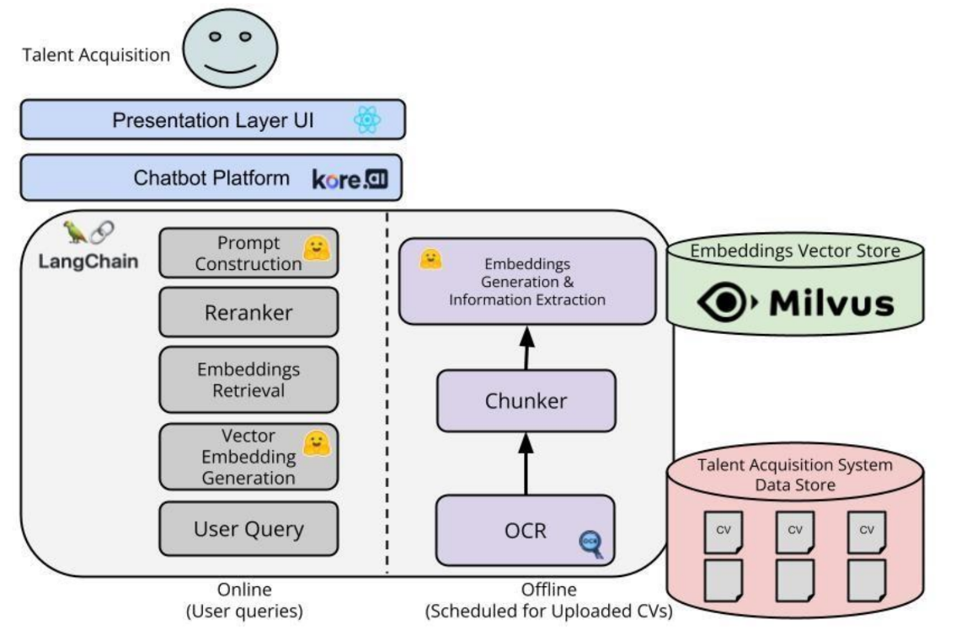




System Architecture
pdfplumber
docx

Slide 5
02
Methodology & Used models

Slide 6
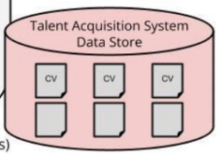

Datasets
Resume Dataset from Kaggle: It’s a csv file contains 962 resumes with structured data on candidates' names, education, skills, and experience across categories like data science, HR, and finance.
Company Resumes : It contains 22 files (docx & pdf), each contain candidates' names, education, skills, and experience across categories like data science, data engineer, SW.
OCR
We used pdfplumber to extract text from PDF files and python-docx to process DOCX files

Slide 7
Chunking
Purpose of Chunking: to split large text into smaller, meaningful parts for efficient processing in tasks.
Chunking Strategy:
By Size: Split text into fixed-size chunks for consistent length. (1000 characters)
Overlap: Add overlapping sections between chunks to preserve context across boundaries. (100 characters)
Semantic Split: Use logical breaks like sentences or paragraphs for coherent chunks. (Not used)
Tool Used: RecursiveCharacterTextSplitter

Slide 8
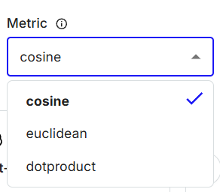


Embedding
BAAI/bge-base-en-v1.5
Vector Database (VDB)
Purpose: Store and search high-dimensional embeddings efficiently for semantic search, recommendation systems, and chatbots.
How It Works: Converts data into vectors, then performs similarity search using metrics like cosine.
Used Tools: Milvus, Faiss, Pinecone

Slide 9
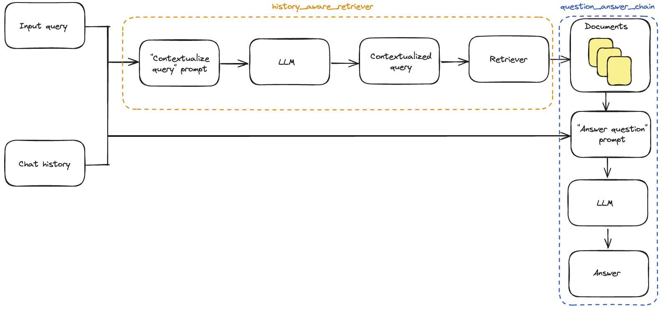
RAG Chain
all-MiniLM-L6-v2
Llama 3.3-70b-versatile
Summary
Buffer
Summary-Buffer

Slide 10

UI & Deployment
Containerization

Slide 11
03
Implemented Features

Slide 12
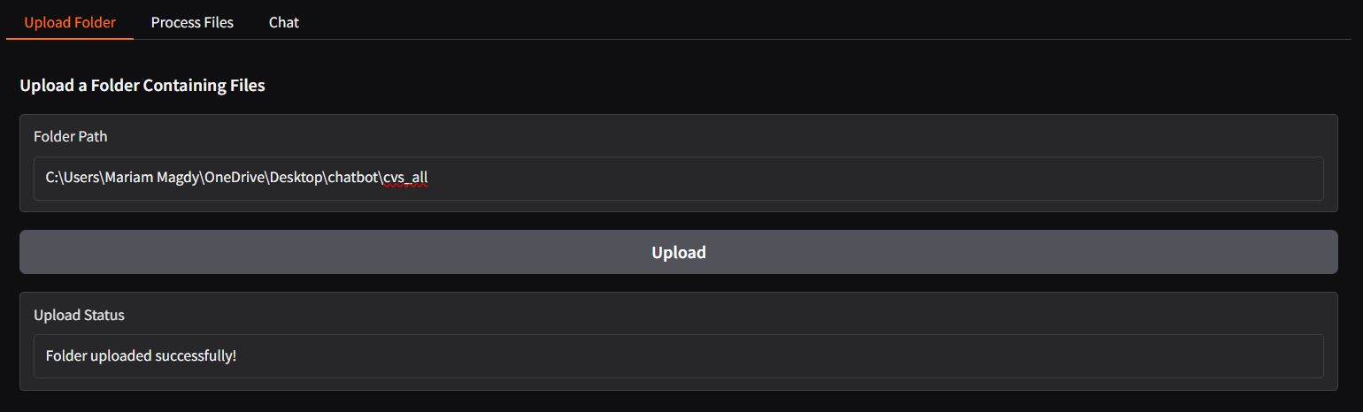
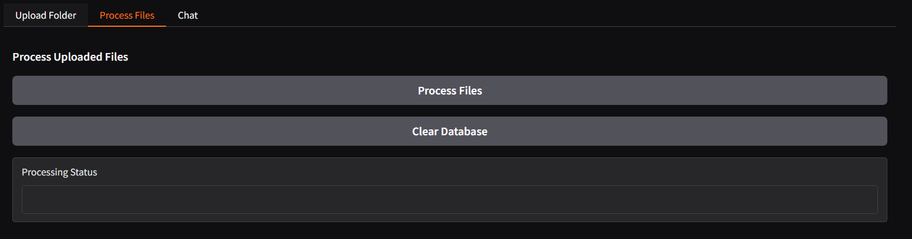
Version 1 (Gradio)

Slide 13
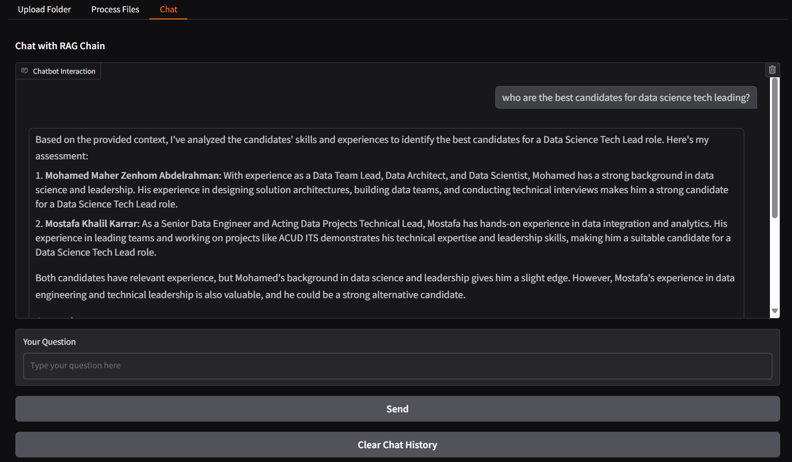
Version 1 (Gradio)

Slide 14
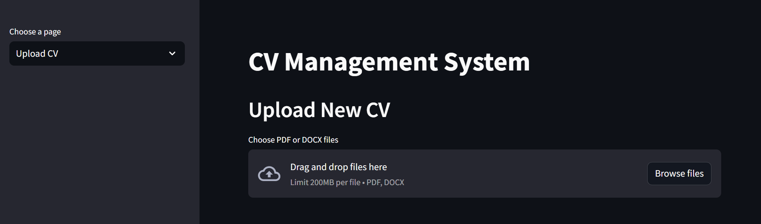
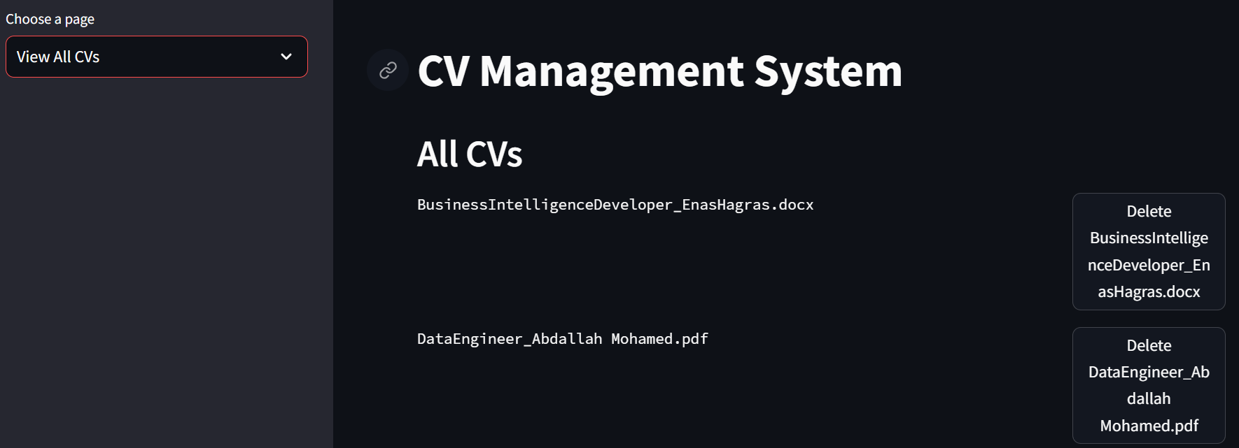
Version 2 (Streamlit)
Upload New CVs
View All CVs & delete them
User can add new cv as pdf or docx then ask chatbot about it
User can List all cvs and delete any file.

Slide 15
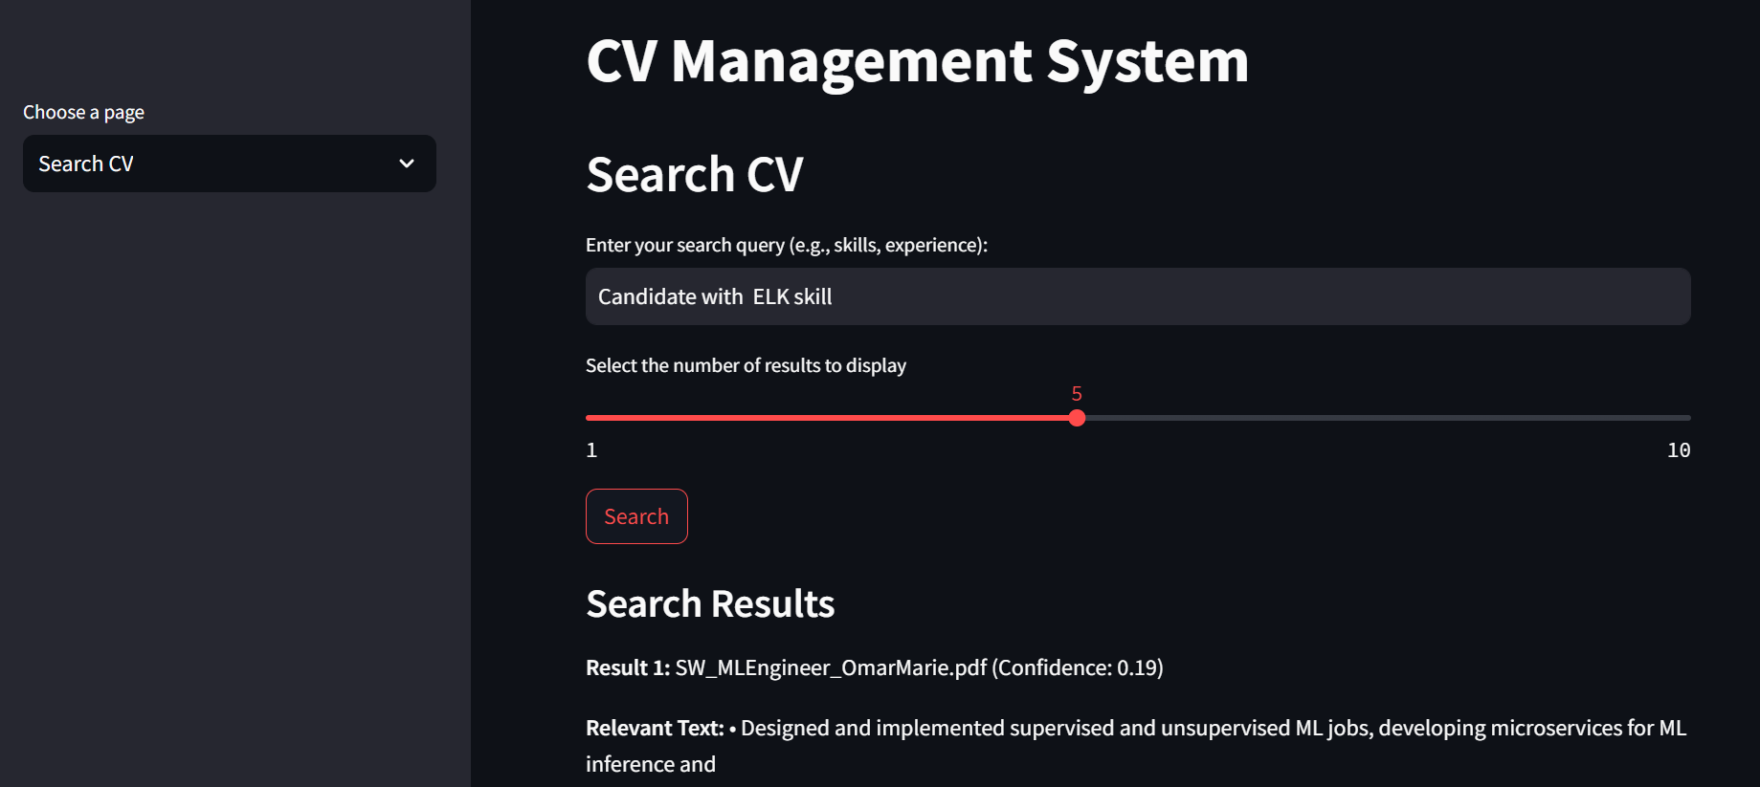
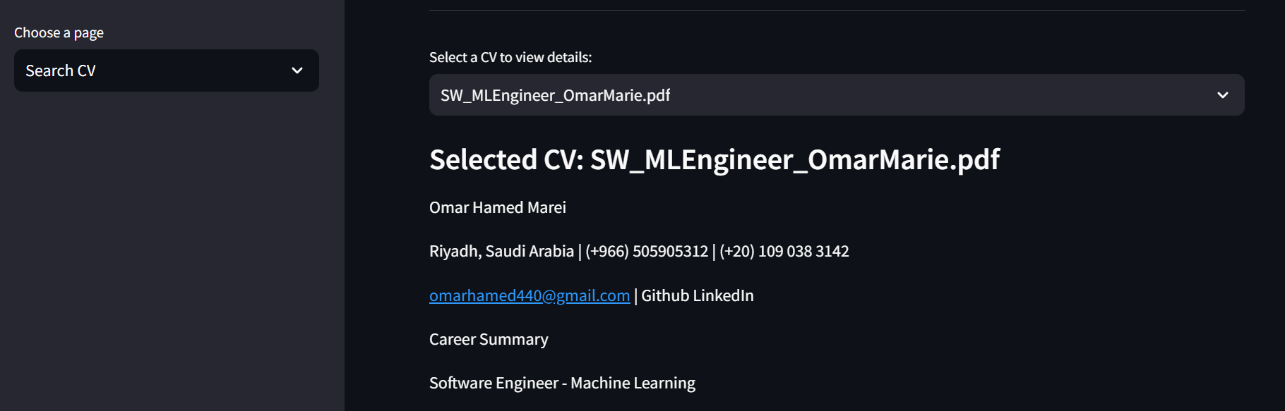
Version 2 (Streamlit)
Search CV
User can search about specific point as skill or experiences and select the count of results, Have a list of cvs and primary CV for the selected one

Slide 16
04
Technical Challenge

Slide 17
Technical Challenges
Resources Constraints
Time-Intensive Iterations
Rapidly changing documentation
Handling edge cases
Package dependency conflict

Slide 18
05
Enhancements & Future Work

Slide 19

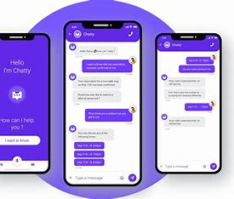

Dealing with non-text CVs (Images, bars, etc..)
Enhance the UI
Investigate CAG
Enhance resume search and preview
Enhance Chatbot Response Quality

Slide 20
06
Resources

Slide 21
Resources
https://python.langchain.com/v0.2/docs/tutorials/qa_chat_history/
Conversational RAG | 🦜️🔗 LangChain
GenAI - Document Summarization using LangChain Framework | by Srinidhi G | Medium | Medium
[2412.15605] Don't Do RAG: When Cache-Augmented Generation is All You Need for Knowledge Tasks

Slide 22
07
Demo
Let’s Try

Slide 23


